Slide 1
RC3
VC 210 Recitation Class
Linda Wei
SJTU

Slide 2
4.Molecular Structure

Slide 3
Chemical Bond
classification:
metal bond
inoic bond
covalent bond (important)

Slide 4
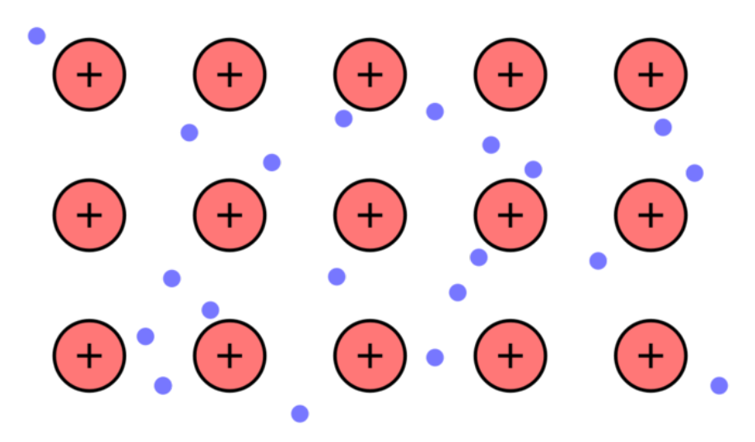
Metal bond

Slide 5
Ionic bond
Metal&NH₄⁺ (losing electrons)-nonmetal (gaining electrons)
Electrostatic attraction between all the ions
Non-directional (没有方向性)
Unlimited number of atoms (没有饱和性)

Slide 6
Ionic Crystal
Lattice energy: the energy released when seperated ions bounded together.
Trend: High lattice energy, stronger the ionic bond, stabler the crystal.

Slide 7
Comparision
First:Compare the electric charge: charge ↑, lattice energy ↑.
Second:Compare the radius of atom (when charge is same): radius ↑, lattice energy ↓

Slide 8
Covalent Bond
Sharing electron
Classification:
sigma bond
pi bond(localized and delocalized)

Slide 9
Lewis Structure
1 Line: bonding pair (single bond: 1 line; double bond: 2 lines, etc.).
2 Dots: lone pairs of electrons (Don’t forget!!).
3 For ionic bond: no lines (representing covalent bond); note electric charge.
4 Consistent with Octet Rule at most time.
Octant Rule: Atoms tend to have nobel-gas configuration in valence shell.

Slide 10
Resonance Structure
Keep relative positions of atoms.
Only change position of electrons.
Number of paired and unpaired electrons unchanged.

Slide 11
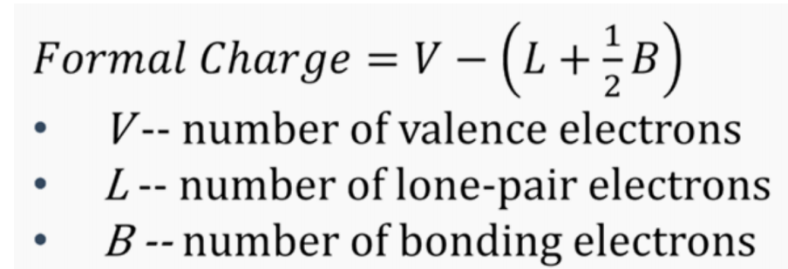
Formal charge

Slide 12
Stable principle
Octant Rule（especially the center atom）
Lower formal charge（especially the center atom）.
More symmetrical structure.
Atom with higher electronegativity has negative formal charge.
Notes:
Lower formal charge.
More symmetrical structure.
Atom with higher electronegativity has negative formal charge.

Slide 13
Beyond Octant Rule
Less than 8 electron: B
eg: BF₃
_{Reason:Delocalized pi-bond}
Less than 8 electron: S,P
eg: SF₆,PCl₅
Reason:Larger orbital, d orbital

Slide 14
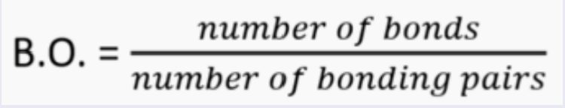
Bond Order(1)
Bond order higher, the strength of the bond higher,the length of the bond is shorter.
the bond order in a resonance structure need to take the
average.

Slide 15
Vallence Bond Theory（1）
Two valence orbitals of two atoms overlap, so two electrons of opposite spin in the orbitals overlap.
Sigma Bond
pi bond

Slide 16
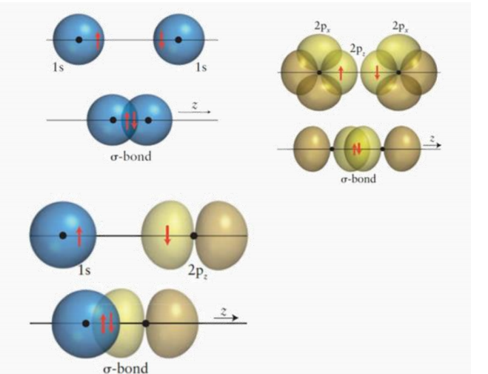
Formation of Sigma Bond(head to head)

Slide 17
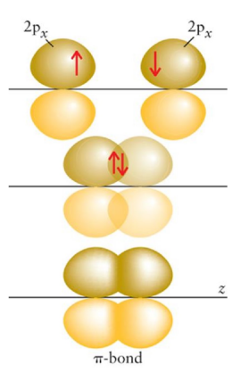
Formation of pi bond(Shoulder to Shoulder)

Slide 18
Property of the two bond
Sigma bond
1、Stronger
2、Can rotate
Pi bond
1、Weaker
2、Can not rotate

Slide 19
Single bond: 1 σ-bond
Double bond: 1 σ-bond & 1 π-bond
Triple bond: 1 σ-bond & 2 π-bond

Slide 20
Molecular Structure
1 VSEPR
2 Hybrid Orbital Theorem

Slide 21
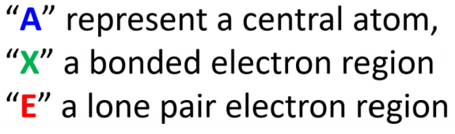
VSEPR
Use it to judge the structure of the following fomula AX_{n}E_{m}
Classification of two kinds of electron pair
Bonding pair: electrons in covalence bond
Nonbonding pair (lone pair): electrons located on one atom

Slide 22
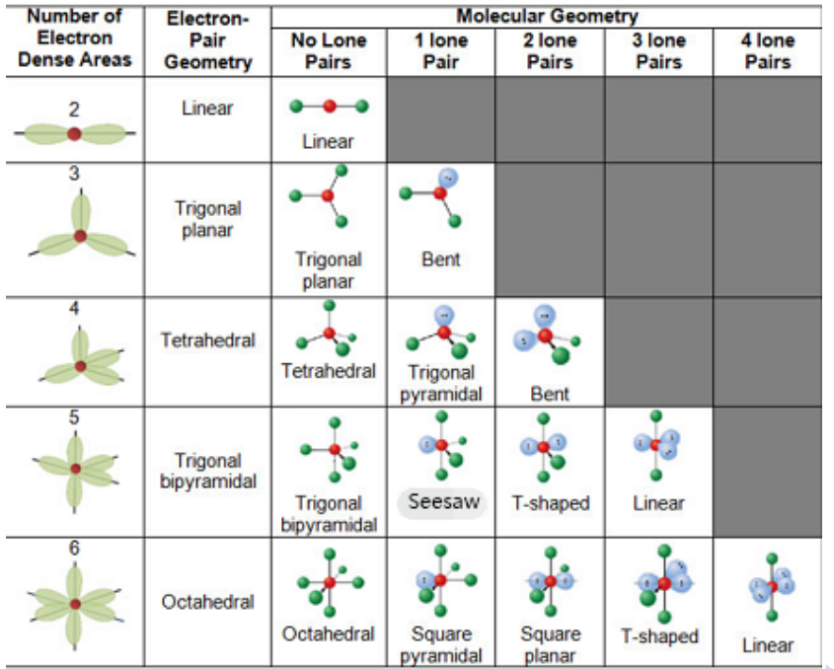
Table

Slide 23
How to calculate
V=m+n
And use the V(look up to the table)

Slide 24
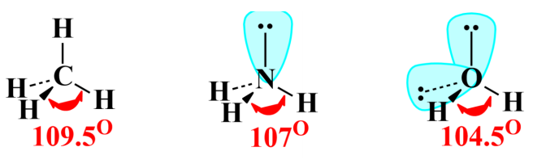
Non-bonding pair
The repulsion between electron pairs:
Non-bonding&non-bonding>non-bonding&bonding>bonding&bonding
This will cause the change of bond angle:
eg:

Slide 25
Polarity
Principle:
If a molecule only has non-polar bonds,it must be non-polar.
Is the molecule shape symmetric? Asymmetric: must be polar.

Slide 26
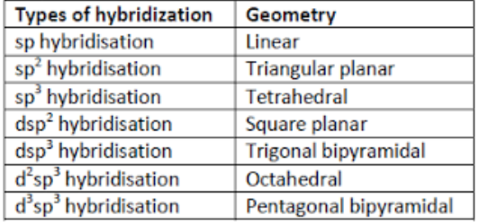
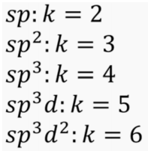
Hybrid
On draft paper
On your cheating paper
In VSEPR:k=m+n
Copy the answer to the paper then you get score.

Slide 27
Thank you

Slide 28
Reference
[1] CHEMICAL PRINCIPLES-THE QUEST FOR INSIGHT
(Seventh Edition)
[2] Wei Xiwen, RC2, VC210 FA2020
[3] Zhou Gongdu, structural chemistry

